Slide 1

Object Communication and Events
Software University
http://softuni.bg
SoftUni Team
Technical Trainers

Slide 2

Table of Contents
Design Patterns
Creational, Structural, Behavioural
Chain of Responsibility
Command
Mediator
Observer

Slide 3
Questions
sli.do #java-fund

Slide 4

Design Pattern
Common Solutions to Common Problems

Slide 5
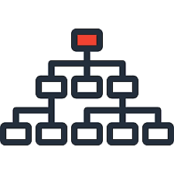

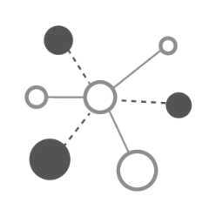

Design Patterns
Structural
All about Class and Object composition
Creational
All about Object creation mechanisms
Behavioral
All about Object communication

Slide 6

Chain of Responsibility
Decoupling Requests

Slide 7
Chain of Responsibility
logger.message("Entering function ProcessOrder().", LogLevel.DEBUG); logger.message("Order record retrieved.", LogLevel.INFO);
Decouples sender and receiver
Chains multiple receivers that can handle a request
Supports undoable requests
logger.message("Entering function ProcessOrder().", LogLevel.DEBUG);
logger.message("Order record retrieved.", LogLevel.INFO);

Slide 8
Chain of Responsibility – UML
Handler, ConcreteHandler
Client
Handler
+handleRequest()
ConcreteHandler
+handleRequest()
ConcreteHandler
+handleRequest()

Slide 9
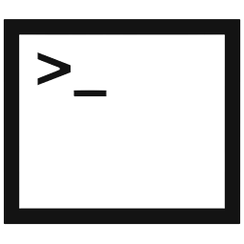
Command Pattern
Encapsulate Requests as an Objects

Slide 10
Command Design Pattern
Callbacks are now Object Oriented
Extending behavior is more flexible
Decouples the Invoker from the Receiver
Callbacks == Functions/Methods
Executor executor = new CommandExecutor();
Receiver receiver = new CommandReceiver();
Request request = new Request(receiver);
executor.execute(request);

Slide 11
Command – UML
Invoker, Receiver
Command, ConcreteCommand
Client
Invoker
Command
+execute()
ConcreteCommand
-state
+execute()
Receiver
+action()

Slide 12
Problem: Command
Create a Command Pattern Executor and provide:
interface Command
void execute()
interface Executor
void executeCommand(Command command)
Concrete Executor named CommandExecutor
Concrete Commands
TargetCommand(Attacker, Target)
AttackCommand(Attacker)

Slide 13
Solution: Command Executor
public interface Command {
void execute();
}
public interface Executor {
void executeCommand(Command command);
}
pubic class CommandExecutor implements Executor {
public void executeCommand(Command command) {
command.execute();
}
}

Slide 14
Solution: Command Executor (2)
public class AttackCommand implements Command {
private Attacker attacker;
public AttackCommand(Attacker attacker) {
this.attacker = attacker;
}
public void execute() {
this.attacker.attack();
}
} // implement TargetCommand

Slide 15

Mediator
Handling Groups of Colleagues

Slide 16
Mediator Design Pattern
Encapsulate how a set of objects interact
Loose coupling of objects
Colleagues are decoupled to one another
Many-to-many relationships between interacting peers

Slide 17
Mediator – UML
Mediator, Colleague
ConcreteMediator, ConcreteColleague
Mediator
Colleague
ConcreteMediator
ConcreteColleague
ConcreteColleague

Slide 18

Observer
Handle Events

Slide 19
Observer Design Pattern
Define a one-to-many relationship
Update observers once an event in the subject occurs
Subject subject = new Subject();
subject.addObserver(new Observer());
mediator.addObserver(new Observer());
// observers are notified after a state change

Slide 20
Observer – UML
Subject, Observer
ConcreteObserver
Subject
-ObserverCollection
+registerObserver(Observer)
+notifyObservers()
Observer
+notify()
ConcreteObserver
ConcreteObserver

Slide 21

Problem: Observer
Implement the following: I
interface Observer
update(int)
interface Subject
void register(Observer)
void unregister(Observer)
void notifyObservers()
If a Target dies, it should send reward to all of its Observers

Slide 22
Solution: Observer
public interface Subject {
void register(Observer observer);
void unregister(Observer observer);
void notifyObservers();
}
public interface Target extends Subject {
…
}
* This is violation of ISP, find a better solution

Slide 23
Solution: Observer
public interface Observer {
void update(int val);
}
… class Warrior implements Attacker, Observer {
// implementation
}

Slide 24
Solution: Observer
public void register(Observer observer) {
this.observers.add(observer);
}
public void unregister(Observer observer) {
this.observers.remove(observer);
}
//Continues on next slide
Add methods to Dragon implementation

Slide 25
Solution: Observer(2)
//…
public void notifyObservers() {
for (Observer observer : observers) {
observer.update(this.reward);
}
}

Slide 26

Summary
…
…
…
Design Patterns, are common solutions to common problems
To learn more about object communication:
Practice behavioural design patterns
Pick a pattern and think of a specific problem where you can use it
Code the solution that you've come up with
The same applies for object creation (Creational patterns) and class structure (Structural patterns)

Slide 27
https://softuni.bg/java-oop

Slide 28
SoftUni Diamond Partners

Slide 29
SoftUni Organizational Partners

Slide 30




Trainings @ Software University (SoftUni)
Software University – High-Quality Education and Employment Opportunities
softuni.bg
Software University Foundation
http://softuni.foundation/
Software University @ Facebook
facebook.com/SoftwareUniversity
Software University Forums
forum.softuni.bg

Slide 31

License
This course (slides, examples, demos, videos, homework, etc.) is licensed under the "Creative Commons Attribution-NonCommercial-ShareAlike 4.0 International" license

